Slide 1
Ultrasound Visualization and Analysis using WASL
Steven M. Lulich
Department of Speech, Language and Hearing Sciences
Indiana University

Slide 2
Overview
General introduction to WASL
Programmability
  Command line
  Plugins
Audio integration
Visualization
  (…and navigation)
Analysis
  Distance
  Canny Edge Detector
  Segmentation (manual, semi-automatic, 3D SLURP)
  Kymograms
Limitations and Conclusion

Slide 3
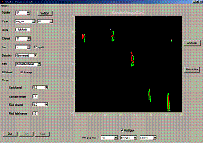
General introduction to WASL
https://spliu.sitehost.iu.edu/software/software.html
FAQ:
  Q: What does WASL mean?
  A: As a brand-new graduate student, I needed to learn how to program in MATLAB. Mark Tiede might not remember this, but he’s the one who taught me – thanks, Mark! I made my first GUI for acoustic and EMA analysis, and I called the program “Wave Analysis by Steven Lulich”. It didn’t do much, and then it was consigned to oblivion. When I started working with 3D/4D ultrasound, I needed to write a new GUI, and I always liked the name “WASL”.

Slide 4
General introduction to WASL
Open-source MATLAB-based Application packaged as a Toolbox
Requires core MATLAB, Signal Processing Toolbox, and Image Processing Toolbox.
Some plugins may require additional Toolboxes.
When you download the Toolbox and install it, you can find out where its files are located:
  >> [WASLdir,~,~] = fileparts(which('WASL'));
Navigate to this directory:
  >> cd(WASLdir);

Slide 5
General introduction to WASL
The directory structure (>> ls;)
  +core
  +plugins
  +utils
  VersionInformation.txt
  WASL.m
  WASLconfig.m
WASL.m is the main function that is called from the command line and sets up the GUI.
WASLconfig.m is a very simply function that identifies which plugins should be loaded by default.

Slide 6
General introduction to WASL
>> edit WASLconfig.m;
% This file must consist of MATLAB-executable commmands. Each command is
% used to load a Plugin into WASL.
%
% By Steven M. Lulich
% October 26, 2016
%
% Last updated by Steven M. Lulich
% April 21, 2020
UserData = plugins.DAT.loadDATtab(UserData,WASLx);
UserData = plugins.STL.loadSTLtab(UserData);
UserData = plugins.CLT.loadCLTtab(UserData);
UserData = plugins.OBL.loadOBLtab(UserData);
UserData = plugins.RSL.loadRSLtab(UserData);

Slide 7
General introduction to WASL
>> edit WASL.m;
Scroll to line 329
% Load Plugins
UserData = plugins.MNG.loadMNGtab(UserData);
UserData = plugins.DCM.loadDCMtab(UserData);
UserData = plugins.KYM.loadKYMtab(UserData);
fid = fopen('WASLconfig.m');
tline = fgetl(fid);
while ischar(tline),
eval(tline);
if ~isempty(tline) & ~strcmp(tline(1),'%'),
dots = findstr(tline,'.');
pluginName = tline(dots(1)+1:dots(2)-1);
UserData.plugin.MNG.plugins.String{end+1} = pluginName;
end;
tline = fgetl(fid);
end;
fclose(fid);
Indispensible plugins
Customizable list of additional default plugins

Slide 8
General introduction to WASL
+core
  Contains core functions that are independent of any plugins
+plugins
  Contains all plugins
+utils
  Contains 3rd-party utilities
The +____ directory name structure allows functions within the directory to be called using dot notation. E.g. core.adjustIntensity;

Slide 9
General introduction to WASL
>> cd(fullfile(WASLdir,'+plugins'));
Each plugin is self-contained in its own directory within +plugins.
Each plugin name must begin with a ‘+’ followed by a three-letter designation. This should preferably be related to the plugin’s function.
  E.g. +CED is a plugin implementing the Canny Edge Detector.
More on plugins later…

Slide 10
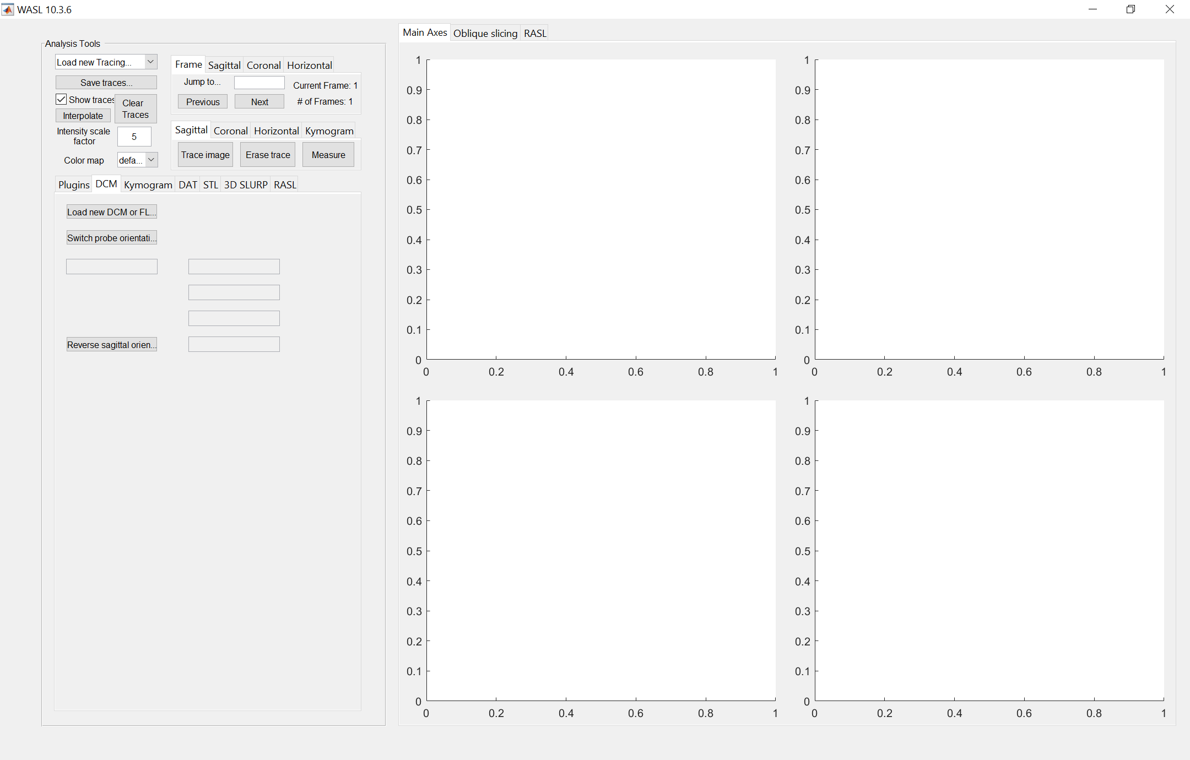
General introduction to WASL
To launch WASL:
  >> h = WASL;
  (or just >> WASL;)
Multiple instances of WASL can be open at the same time. The various instances of WASL do not interact or interfere with each other in any way.

Slide 11
General introduction to WASL
Core functions
Primary plugins
Secondary plugins

Slide 12
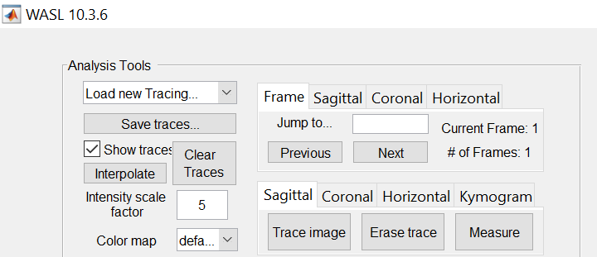
General introduction to WASL
Core Functions
  Manipulation of traces (tongue segmentations)
  Color map and intensity
  Frame-by-frame and slice-by-slice navigation
  Toggle buttons to
    Create manual trace
    Erase manual trace
    Measure linear distance

Slide 13
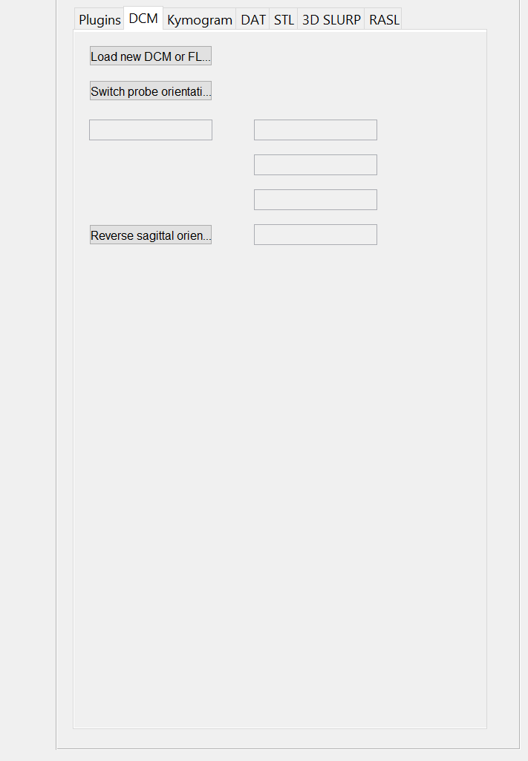
General introduction to WASL
Primary Plugins
  Each plugin has its own Tab associated with it.
  All of the plugin’s user interface tools are located within its Tab.
  Plugin variables (with a few exceptions) are temporarily stored in h.UserData.plugin.---, where ‘---’ is the plugin’s three-letter designation. E.g. h.UserData.plugin.CED for the Canny Edge Detector.

Slide 14
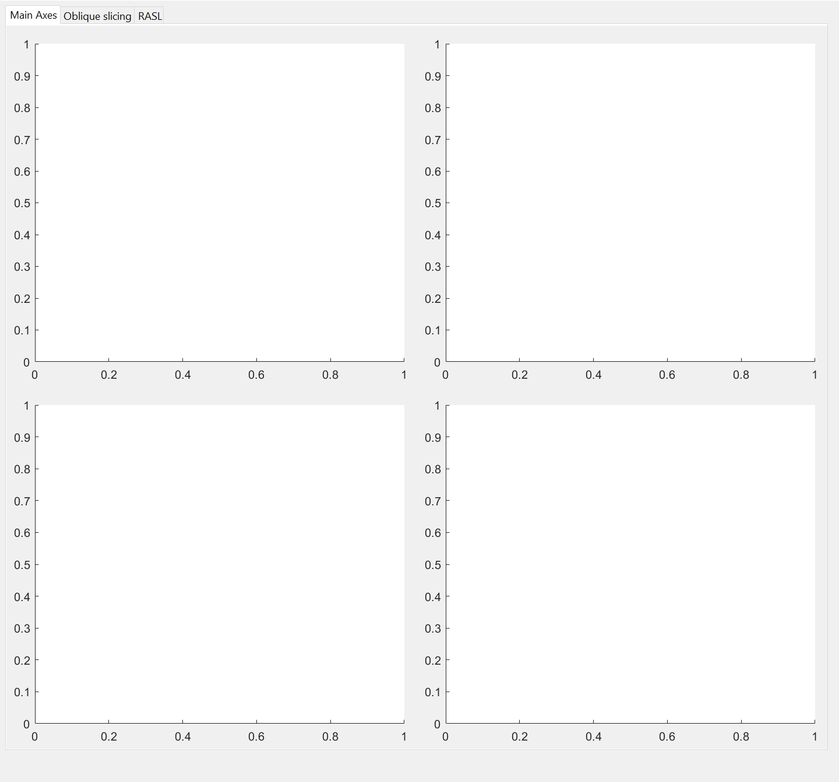
General introduction to WASL
Secondary Plugins
  For plugins that need more space for data visualization.
  In all ways identical to Primary Plugins except for the TabGroup they are placed in.

Slide 15
General introduction to WASL
Design Principles
  User friendly
  Rapid development of new functions (plugins)
  Spatio-temporal analysis of 3D/4D ultrasound with synchronous audio

Slide 16
Overview
General introduction to WASL
Programmability
  Command line
  Plugins
Audio integration
Visualization
  (…and navigation)
Analysis
  Distance
  Canny Edge Detector
  Segmentation (manual, semi-automatic, 3D SLURP)
  Kymograms
Limitations and Conclusion

Slide 17
Programmability (Command line; Plugins)
All variables are stored in the MATLAB Figure’s property “UserData”.
>> h = WASL;
>> h.UserData
ans =
struct with fields:
superDirectory: 'C:\Users\Steven\Documents\MATLAB\Add-Ons\Toolboxes\WASL‘
tabGroups: [1×1 struct]
mainAxesTabGroup: [1×1 TabGroup]
mainAxes: [1×1 struct]
axes: [1×1 struct]
pluginTabGroup: [1×1 TabGroup]
plugin: [1×1 struct]
functions: {@plugins.KYM.dispKym @plugins.CLT.dispCLT}
settings: [1×1 struct]
Variables associated with plugins
Functions associated with plugins that should automatically be called whenever necessary, e.g. there is a change in the frame or slice being viewed

Slide 18
Programmability (Command line; Plugins)
WASL is primarily a GUI, secondarily command-line accessible
Examples of functions accessible from the command line:
  h = WASL;
  [V, scaling] = plugins.DCM.loadnewFLD(h, pathname, filename);
  h = plugins.DCM.switchOrientation(h);
  h = plugins.DCM.reverseSagOrientation(h);
Command line accessibility allows for batch processing inside of scripted loops.

Slide 19
Programmability (Command line; Plugins)
All plugins have a common architecture. A sample plugin called +TST (“TEST”) is included with WASL
  cd(fullfile(WASLdir,'+plugins','+TST'));
Inside the plugin directory:
  loadTSTtab.m - Sets up the Tab in the GUI.
  dispTST.m - A function to be run automatically when necessary
  (e.g. the frame or slice being viewed changes.
  exampleOfDoingSomething.m
  - A silly function accessed through the GUI.

Slide 20
Programmability (Command line; Plugins)
load---tab.m
  This function must be present in every plugin, and it must be named according to this convention, where “---” refers to the three-letter designation for the plugin.
disp---.m
  This function is optional and has no special naming convention requirements
Additional plugin-specific functions that are accessed by user interactions with the GUI.

Slide 21
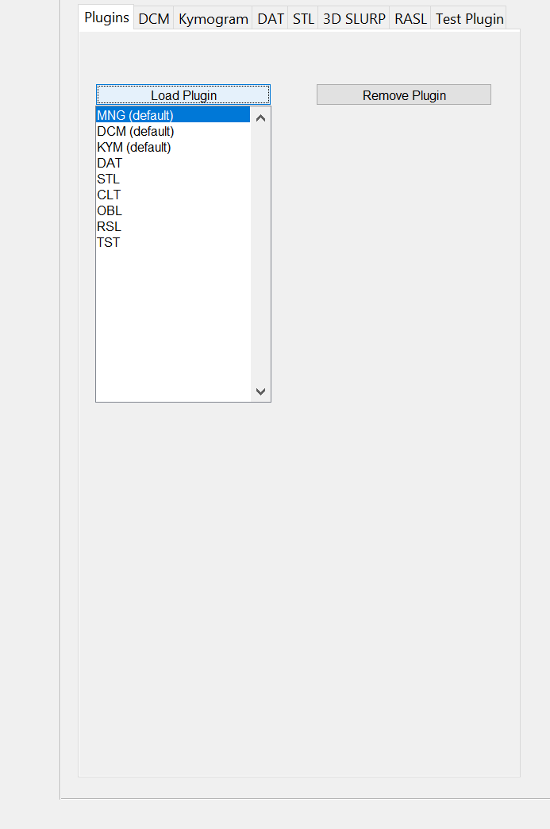
Programmability (Command line; Plugins)
To load a plugin into WASL:
  Enter the “Plugins” Tab, press the “Load Plugin” button, and browse for the +TST (or other) plugin directory. A new tab will appear at the end of the primary or secondary plugin TabGroup.

Slide 22
Programmability (Command line; Plugins)
function UserData = loadTSTtab(UserData);
UserData.plugin.TST.tab = ...
uitab(UserData.pluginTabGroup,'title','Test Plugin');
UserData.plugin.TST.axes = ...
axes(UserData.plugin.TST.tab,'Position',[0.1 0.6 0.8 0.3], ...
'Units','normalized');
UserData.plugin.TST.pushbutton = ...
uicontrol(UserData.plugin.TST.tab,'Style','pushbutton', ...
'Callback',@plugins.TST.exampleOfDoingSomething, ...
'Units','normalized','Position',[0.1 0.2 0.5 0.2], ...
'String','Do something');
UserData.plugin.TST.line = ...
plot(UserData.plugin.TST.axes,[rand(1) rand(1)]*1.8-0.9, ...
[rand(1) rand(1)]*1.8-0.9,'k-');
UserData.plugin.TST.axes.XLim = [-1 1];
UserData.plugin.TST.axes.YLim = [-1 1];
try,
UserData.functions{end+1} = @plugins.TST.dispTST;
catch,
UserData.functions{1} = @plugins.TST.dispTST;
end;
Required: Create the Tab for the plugin
Additional plugin-specific functions that are accessed by user interactions with the GUI.
Optional: Identify the function that should automatically run when necessary

Slide 23
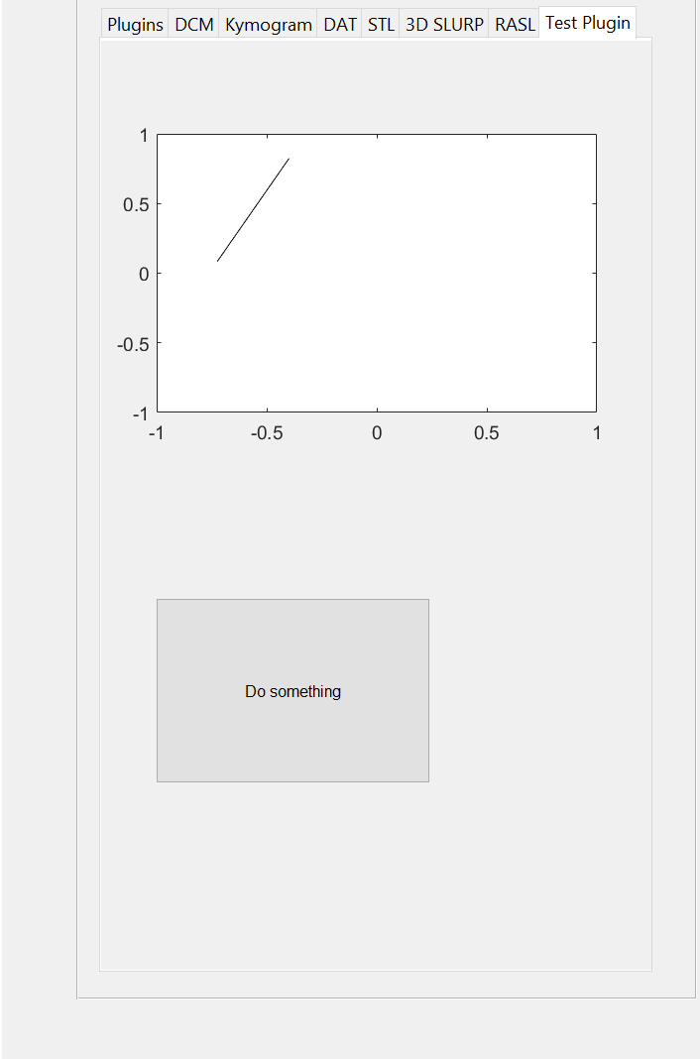
Programmability (Command line; Plugins)
function UserData = loadTSTtab(UserData);
UserData.plugin.TST.tab = ...
uitab(UserData.pluginTabGroup,'title','Test Plugin');
UserData.plugin.TST.axes = ...
axes(UserData.plugin.TST.tab,'Position',[0.1 0.6 0.8 0.3], ...
'Units','normalized');
UserData.plugin.TST.pushbutton = ...
uicontrol(UserData.plugin.TST.tab,'Style','pushbutton', ...
'Callback',@plugins.TST.exampleOfDoingSomething, ...
'Units','normalized','Position',[0.1 0.2 0.5 0.2], ...
'String','Do something');
UserData.plugin.TST.line = ...
plot(UserData.plugin.TST.axes,[rand(1) rand(1)]*1.8-0.9, ...
[rand(1) rand(1)]*1.8-0.9,'k-');
UserData.plugin.TST.axes.XLim = [-1 1];
UserData.plugin.TST.axes.YLim = [-1 1];
try,
UserData.functions{end+1} = @plugins.TST.dispTST;
catch,
UserData.functions{1} = @plugins.TST.dispTST;
end;

Slide 24
Programmability (Command line; Plugins)
Let’s build a plugin that will load 2D ultrasound images or videos into WASL!
We need:
  A user interface Tab to handle file selection
  An output that places the ultrasound data in h.UserData
We will:
  Keep it simple

Slide 25
Programmability (Command line; Plugins)
Step 1: Create a new copy of the +TST folder and name it +U2D (“Ultrasound 2D”).
Step 2: Rename the copied loadTSTtab.m → loadU2Dtab.m
Step 3: Delete the copied dispTST.m and exampleOfDoingSomething.m functions.
Step 4: Edit loadU2Dtab.m
  Replace “TST” with “U2D” everywhere in the function
  Rename the Tab display name from “Test Plugin” to “Load 2D US”
  Delete everything else except the pushbutton, and edit the pushbutton

Slide 26
Programmability (Command line; Plugins)
function UserData = loadU2Dtab(UserData);
UserData.plugin.U2D.tab = ...
uitab(UserData.pluginTabGroup,'title','Load 2D US');
UserData.plugin.U2D.pushbutton = ...
uicontrol(UserData.plugin.U2D.tab,'Style','pushbutton', ...
'Callback',@plugins.U2D.loadnewU2D, ...
'Units','normalized','Position',[0.1 0.2 0.5 0.2], ...
'String','Load new 2D Ultrasound data');
Required: Create the Tab for the plugin
Additional plugin-specific functions that are accessed by user interactions with the GUI.

Slide 27
Programmability (Command line; Plugins)
Step 5: Write a function (loadnewU2D.m) that selects a 2D ultrasound data file and loads it into WASL.
function varargout = loadnewU2D(varargin);
WASLx = gcbf;
UserData = WASLx.UserData;
[filename, pathname, filterindex] = uigetfile(defaultFile, 'Pick a 2D US file');
if filename == 0, % If no file was chosen, quit early.
return;
end;
switch filename(end-2:end),
case 'jpg',
I = imread(fullfile(pathname,filename),'jpg');
if ndims(I) == 3,
I = rgb2gray(I);
end;
I = cat(3,I,I);
I = cat(4,I,I);
if ~isfloat(I),
I = double(I);
end;
otherwise,
end;
scaling.scale = [1 1 1 1];
scaling.C = size(I);
UserData.tongue.V = I;
UserData.tongue.scaling = scaling;
WASLx.UserData = [];
WASLx.UserData = UserData;
Interface with WASL
Load JPG
Plugin-specific code
Load other formats…
Output to WASL variable structure
*The code is really a bit more complicated than shown, but this conveys the main ideas.

Slide 28
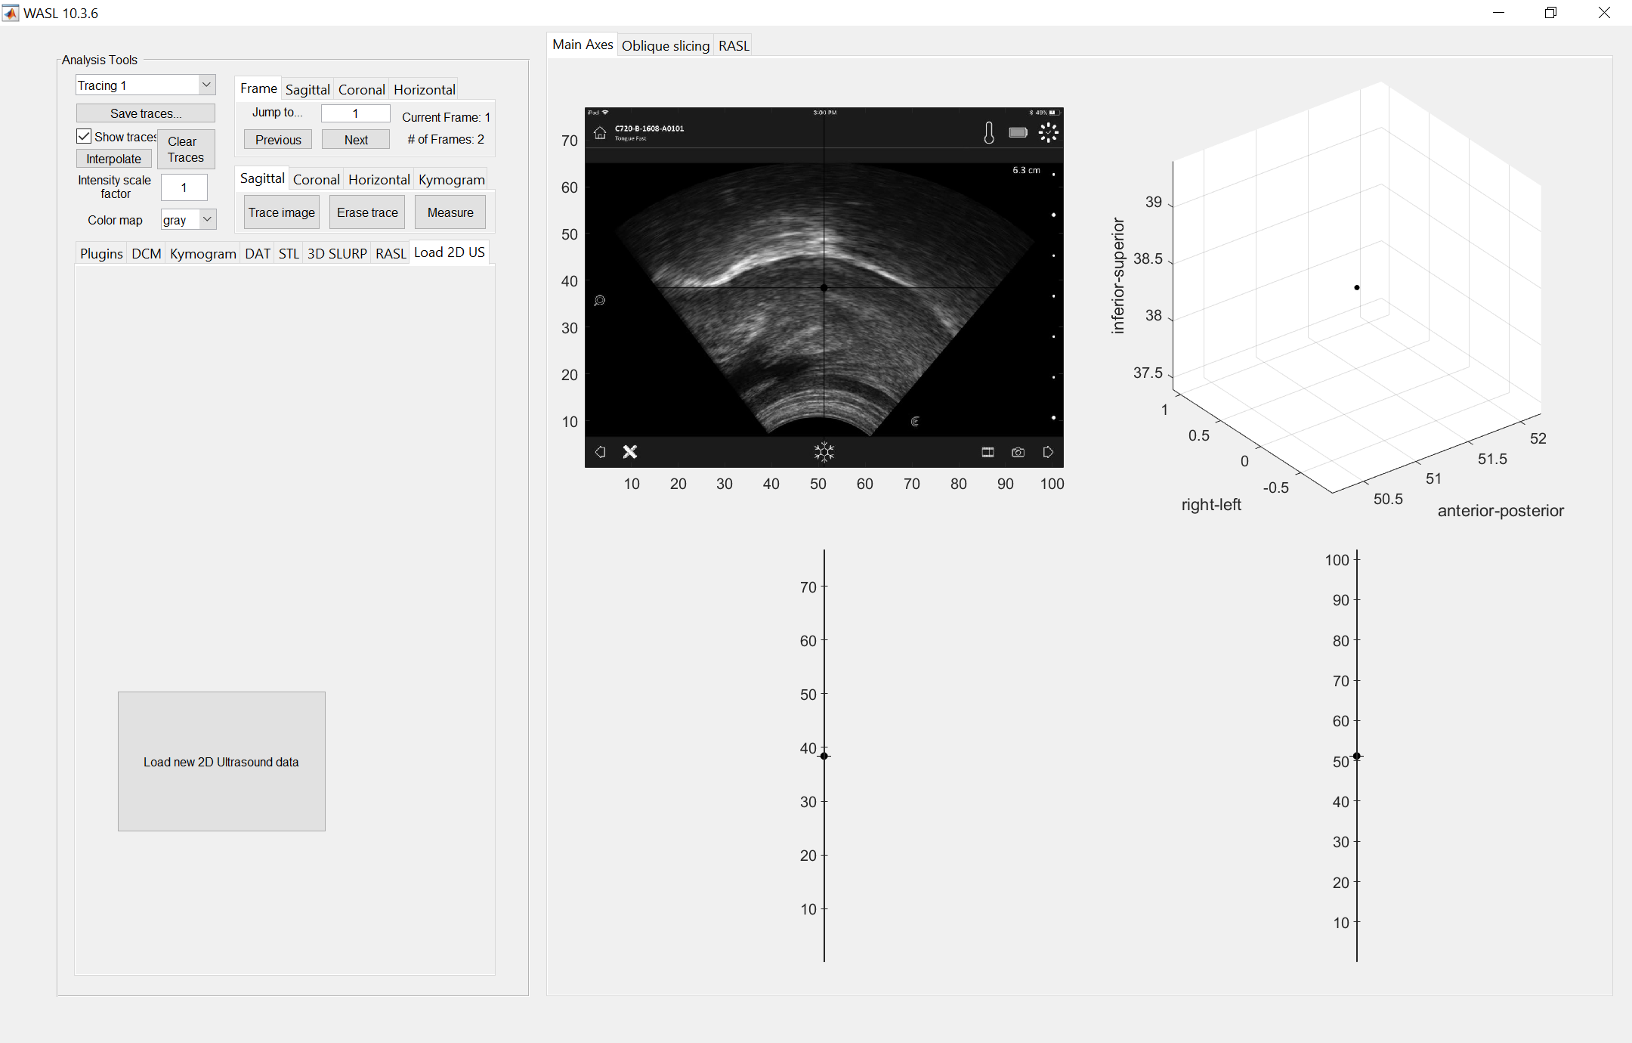
Programmability (Command line; Plugins)
Two simple functions in the new plugin enable a JPG to be read into WASL.
Because WASL was designed for 3D/4D ultrasound, additional axes show counterfactual coronal and transverse slices.
Ultrasound image from https://clarius.com/ultrasound-got-your-tongue/

Slide 29
Overview
General introduction to WASL
Programmability
  Command line
  Plugins
Audio integration
Visualization
  (…and navigation)
Analysis
  Distance
  Canny Edge Detector
  Segmentation (manual, semi-automatic, 3D SLURP)
  Kymograms
Limitations and Conclusion

Slide 30
Audio integration
A design principle of WASL was:
  Spatio-temporal analysis of 3D/4D ultrasound with synchronous audio
Corresponding ultrasound and audio data can be loaded into WASL and synchronized.
Real-time playback works on very fast computers.
Videos can be exported for real-time playback outside of MATLAB.

Slide 31

Audio integration
Example of exported video:
And now for a live demonstration with the same data…

Slide 32
Overview
General introduction to WASL
Programmability
  Command line
  Plugins
Audio integration
Visualization
  (…and navigation)
Analysis
  Distance
  Canny Edge Detector
  Segmentation (manual, semi-automatic, 3D SLURP)
  Kymograms
Limitations and Conclusion

Slide 33
Visualization (…and navigation)
WASL offers simple visualization and navigation tools
A new tool for oblique slicing is in development
Live demonstration…

Slide 34
Overview
General introduction to WASL
Programmability
  Command line
  Plugins
Audio integration
Visualization
  (…and navigation)
Analysis
  Distance
  Canny Edge Detector
  Segmentation (manual, semi-automatic, 3D SLURP)
  Kymograms
Limitations and Conclusion

Slide 35
Analysis
Distance
Canny Edge Detector
Segmentation (manual, semi-automatic, 3D SLURP)
Kymograms
Live demonstration…

Slide 36
Overview
General introduction to WASL
Programmability
  Command line
  Plugins
Audio integration
Visualization
  (…and navigation)
Analysis
  Distance
  Canny Edge Detector
  Segmentation (manual, semi-automatic, 3D SLURP)
  Kymograms
Limitations and Conclusion

Slide 37
Limitations and Conclusion
Although WASL is open-source, MATLAB is not
Implementation of many WASL functions is clunky and inefficient
Sometimes WASL is buggy
User documentation is (very) underdeveloped
Limited range of file formats currently supported
  … but plugins can help!

Slide 38
Thank you!
Funded for development of WASL came from NSF Grant #1151131 and start-up funds from Indiana University.
Thanks to Hao Lu, Jonathan Washington, Tamás Csapó, Brandon Rhodes, Olivia Foley, Kelly Berkson, Kenneth de Jong, and Sherman Charles for contributions to the development of WASL.
Thanks to Mark Tiede for teaching me how to program in MATLAB.

